Slide 1

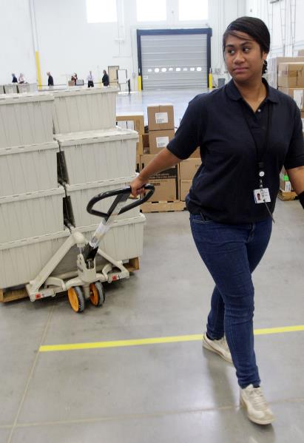

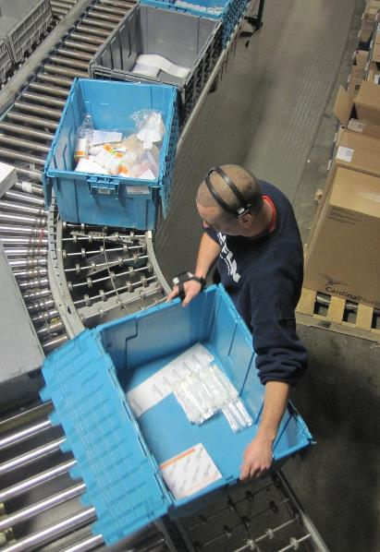
Healthcare Distribution | Overview

Slide 2

The Medical Products Supply Chain Is Global

Slide 3


The US Distribution Supply Chain Is Local
Hundreds of distribution centers within a 50-mile radius of most urban centers

Slide 4





Healthcare Providers Rely On Distributors For Their Supplies
Thousands Of Manufacturers Worldwide
Hundreds Of US Distributors
6,000 Hospitals
44,500 Nursing Homes And Assisted Living Facilities
230,000 Physician Offices
And Clinics

Slide 5
Distributors Save Healthcare Providers Time And Money While Delivering The FDA-Approved Supplies They Need

Slide 6

Distributors Provide Predictability For
Healthcare Providers
Distributors operate under multi-year contracts with healthcare providers that establish pricing and service
Notes:
So what are we really talking about?
With bulk distribution…
With JIT, deliveries are more frequent, allowing the hospital to reduce the size of storeroom inventory.
With stockless, it isn’t just the inventory that’s moved to the distributor, it’s most of the logistics tasks as well.
These are the many small but time consuming manual tasks involved in the pick and pack of orders for the floors. By aggregating them at the distributor level, they are combined into a volume of work that justifies automation. Ideally, the distributor is performing these tasks for many hospitals and can therefore gain considerable savings through productivity gained by using automated equipment like pick carousels, extensive production line conveyors, flow racks and computerized picking systems like voice activated or pick to light mechanisms.
Theoretically, the savings are shared by all customers on the system. Both accuracy and efficiency are improved.
LUM is used as a broad catch-all for both JIT and stockless.

Slide 7
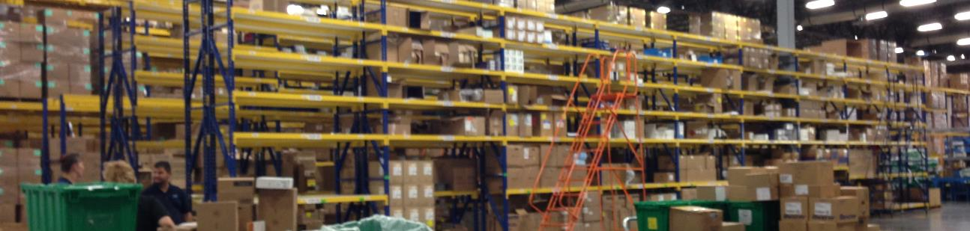

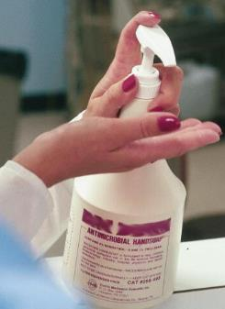

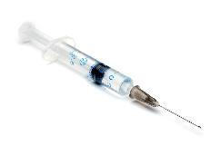



Distributors Secure, Store, And Deliver Thousands Of Types Of Products
20–30 Day Supply
Diagnostics
Infection Prevention
Personal Protection
Treatment Products

Slide 8
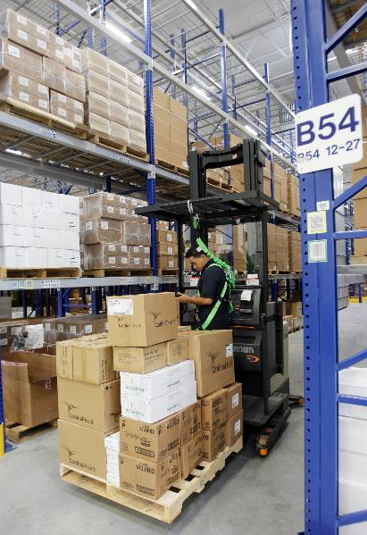
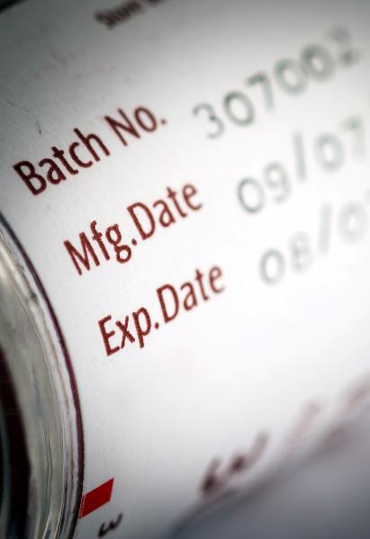
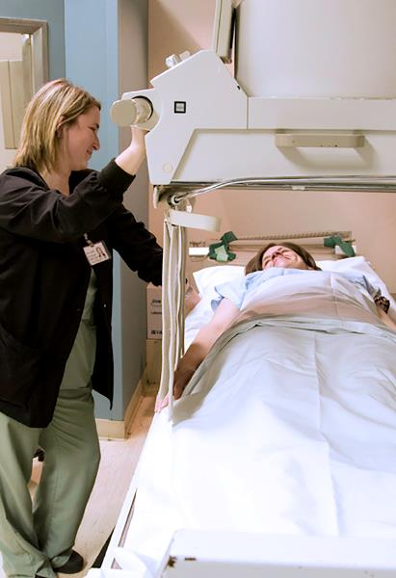
Healthcare Providers Aren’t In the Logistics Business
Managing inventory is expensive and takes up space
Products must be handled and stored properly to ensure quality and security
Large inventories risk expiration, damage, and obsolescence
Providers need to optimize space for patient care

Slide 9
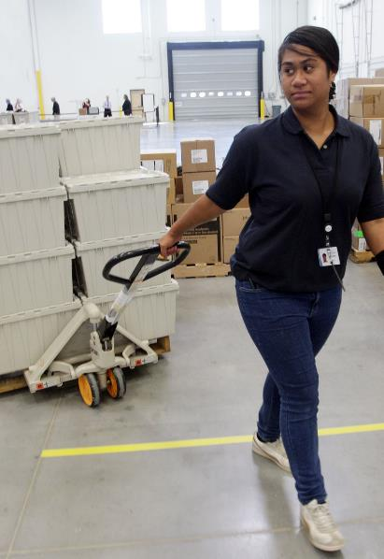

Distributors Are Logistics Experts
Dedicated warehouse space
Formulary support and
data services
Low-unit-of-measure programs

Slide 10
Distribution Varies By Provider Setting
Hospital Distributors
Hospital Storeroom/
Warehouse
6,000 Hospitals
8-10 National Full-Line Distributors
Regional and Specialty Distributors
Nursing Homes, Physicians’ Offices Distributors
Smaller Quantity Deliveries
15,600 Nursing Homes
28,900 Assisted Living
Facilities
12,200 Home Health
Agencies
Storeroom
National Distributors
Hundreds Of Independent Distributors
Small Quantities Packaged For Delivery In Boxes
230,000 Physician Offices And
Clinics

Slide 11


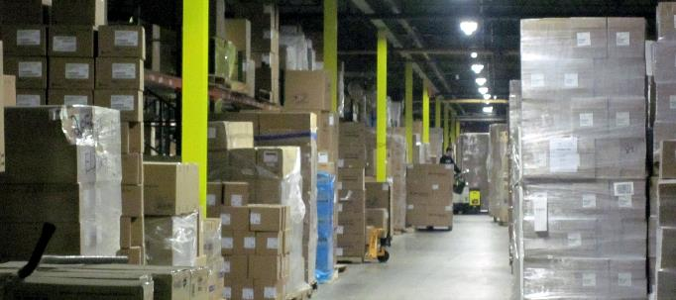
Distributors Are A Critical Part Of Crisis Response
Weather alerts, alternate delivery routes
Automatic reorders in the event
of communications failure
Automated tracking of inventories, average usage rates
Automatic item substitution
for critical items
Sequestered products reserved for specific customers based on agreed-upon inventory levels

Slide 12


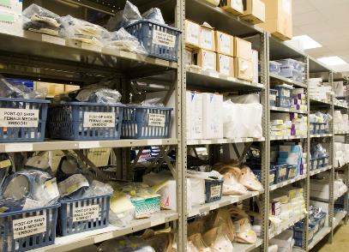


Distributors Responded To COVID-19 Quickly
Vetted and onboarded
new suppliers
Identified appropriate product substitutions
Coordinated with current suppliers to ramp up production
Expedited shipping and delivery to hotspots to all healthcare provider settings
Helped healthcare providers determine supply availability and delivery dates

Slide 13
COVID-Driven Demand Created Supply Problems That Have Challenged The Supply Chain
Entry Of Brokers
Created A “Wild West” Marketplace
Huge and fast: Up to 17x from hospitals
Worldwide
New and non-traditional buyers entered the market
Increased
Demand
Decreased
Supply
COVID-19 originated in a major PPE manufacturing center causing extended regional closures
Rise of
opportunity
marketplace
where brokers with no healthcare experience engaged in fraud and profiteering

Slide 14
Brokers Aren’t Distributors
Brokers
Distributors
One-time deals for the highest price
Prices based on long-term relationships and contracts with manufacturers and healthcare providers
Price
No guarantee that manufacturers were vetted or that broker has experience in healthcare supply
Sourced from vetted and
FDA-approved manufacturers
Safety
Only negotiate, no guarantees of product delivery or condition
Take possession of products and deliver to healthcare provider
Quality

Slide 15

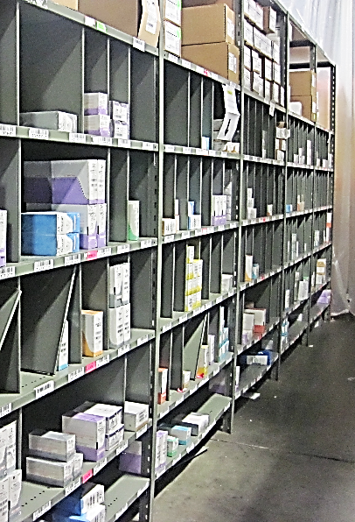
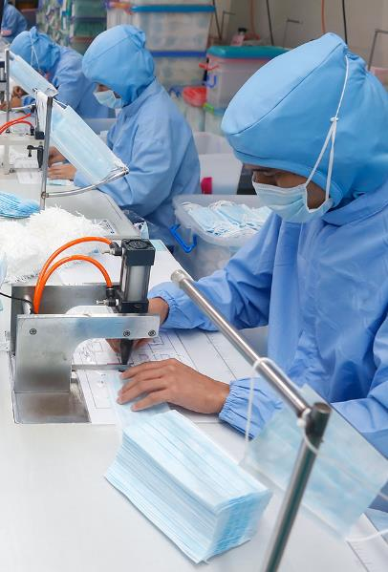
Distributors Support Policy And Legislation That:
Creates a partnership
with government and distributors
Taps distributor expertise to establish and manage national reserve of key medical supplies
Identifies ways to diversify production

Slide 16
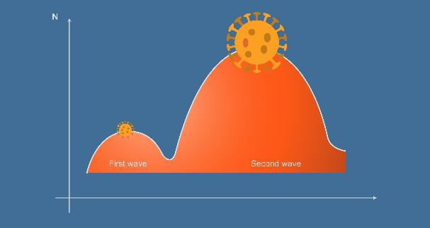



Distributors Are Ready To Work With Public Partners, Healthcare Providers, Legislators
And Regulators To Meet Future Challenges
Second Wave
Increased Testing
Resumption Of Elective Surgery
Nationwide Vaccine Delivery

Slide 17
HIDA.org

